Slide 1
Sprint 3
Level shifts

Slide 2
strucchange package
For modeling mean changes

Slide 3
Strucchange package
Pros:
Mature package
Relatively fast: 5 min average
Cons:
Uses lots of memory (+5GB on some cases)

Slide 4
Strucchange package

Slide 5
Level shift?

Slide 6
Level shift?

Slide 7
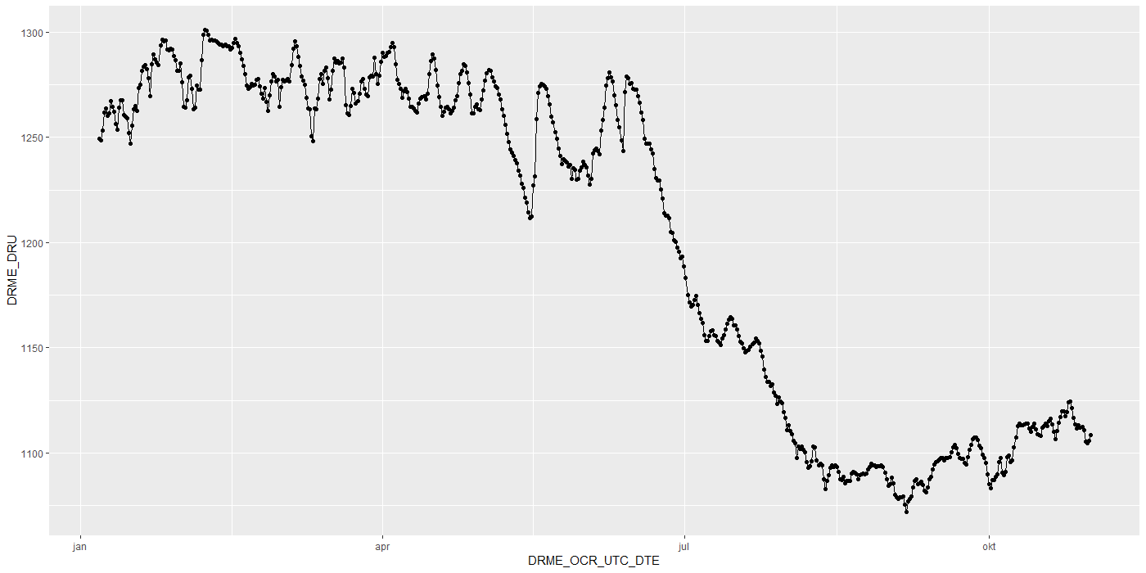
Level shift?

Slide 8
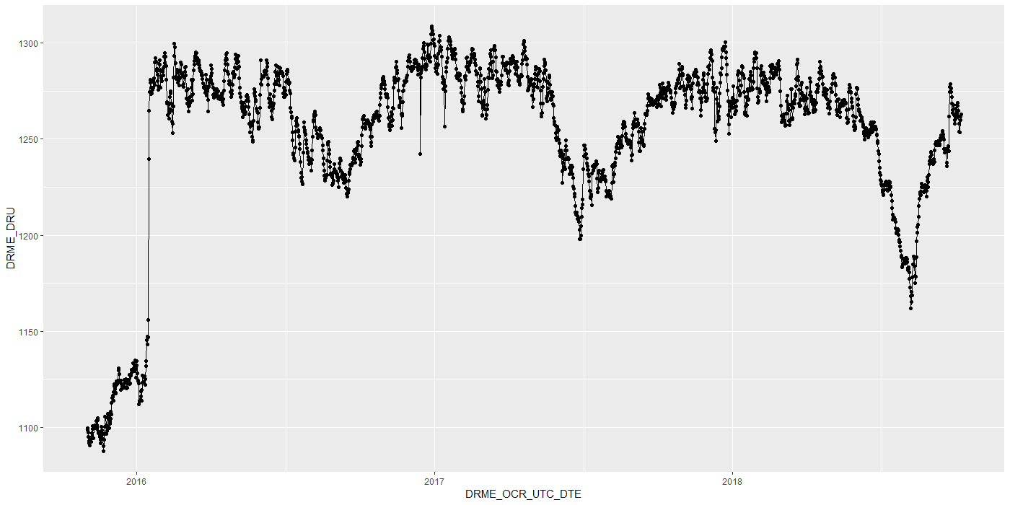
Level shift?

Slide 9
Level shift?

Slide 10
tsoutliers package
Level Shifts

Slide 11
tsoutliers package

Slide 12
Rank based level shift detection
Fried, R. e.a., On rank tests for shift detection in time series, 2007
Bovik, A.C. e.a., Nonparametric Tests for Edge Detection in Noise, 1986
Based on the distribution of a test statistic (e.g. Wilcoxon statistic) the normal situation can be defined. Based on this definition, exceptional situations could be detected.
Pro: speed!

Slide 13
Timestamps

Slide 14
Importance
Visualization:
Its either TIMESTAMP or SEQUENCE
INBO:
Can make sure that timestamp is always available.
Other parties?

Slide 15
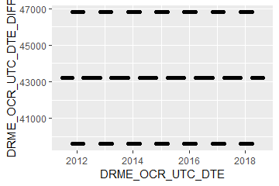
Timestamps: varying time-difference between observations (BAOL068X_180816.csv)
Sometimes 11, 12 or 13 hours
Notes:
BAOL068X_180816.csv

Slide 16
Timestamps: varying time-difference between observations
Equidistant observations are important for ARIMA-like timeseries models.
Without equidistance, the usability of ARIMA is limited.
Example: Differencing
For small time-differences: measured differences determined by sensor inaccuracy
For large time-differences: measured differences determined by sensor inaccuracy and atmospheric changes.
Timestamps: Take into account all kinds of scenarios?

Slide 17
gwloggeR
Change log
Feedback?

Slide 18
Change log
“Diver” → “hydrostatic pressure”
ap <- apriori("hydrostatic pressure", "cmH2O")
detect_outliers(x, apriori = ap)
detect_duplicates(ts)

Slide 19
Aggregation function

Slide 20
Next steps

Slide 21
Next steps
Outliers v0.02
Build kernel based on clean data
Document in detail
Notes:
temporal change : multiple points after the change should be “red”
Level shifts: how to flag those?

Slide 22
Hysteresis?

Slide 23
The End

Slide 24
Sprint 2
Outliers

Slide 25
Agenda
DRME_DMST_CDE validation
Outliers: v0.02 update
Comparison v0.01 vs v0.02
gwloggeR v0.1.1
Assessment
anomalize
tsoutliers

Slide 26
DRME_DMST_CDE
Flags from DB: ENT (entered); DEL (deleted) and INV (invalid).

Slide 27
DRME_DMST_CDE
On all *.csv-data:
DEL ENT INV VLD <NA>
462 556271 4697 16 0

Slide 28
DRME_DMST_CDE: VLD and DEL
PPNT_ID PPNT_CDE DRSO_ID DRSO_SER_NBR DRME_ID DRME_OCR_UTC_DTE DRME_DRU DRME_TPU DRME_DMTP_CDE DRME_DMST_CDE SEQUENCE
1: 7019 BAOL001X 275 D0939 238389 2010-11-11 10:00:00 1018.100 NA LDME VLD 1093
2: 7019 BAOL001X 275 D0939 1824560 2010-11-11 10:00:00 1018.075 6.033 LDME ENT 1130
3: 7019 BAOL001X 275 D0939 238390 2010-11-11 22:00:00 1007.300 NA LDME VLD 1094
4: 7019 BAOL001X 275 D0939 1824561 2010-11-11 22:00:00 1007.275 8.163 LDME ENT 1131
5: 7019 BAOL001X 275 D0939 238391 2010-11-12 10:00:00 1015.400 NA LDME VLD 1095
6: 7019 BAOL001X 275 D0939 1824562 2010-11-12 10:00:00 1015.375 11.213 LDME ENT 1132
7: 7019 BAOL001X 275 D0939 238392 2010-11-12 22:00:00 1012.900 NA LDME VLD 1096
8: 7019 BAOL001X 275 D0939 1824563 2010-11-12 22:00:00 1012.850 12.457 LDME ENT 1133
9: 7019 BAOL001X 275 D0939 238393 2010-11-13 10:00:00 1014.600 NA LDME VLD 1097
10: 7019 BAOL001X 275 D0939 1824564 2010-11-13 10:00:00 1014.600 10.810 LDME ENT 1134
11: 7019 BAOL001X 275 D0939 238394 2010-11-13 22:00:00 1012.700 NA LDME VLD 1098
12: 7019 BAOL001X 275 D0939 1824565 2010-11-13 22:00:00 1012.675 10.953 LDME ENT 1135
Duplicates: Detect those too?
Notes:
Duplicaten in de DB?

Slide 29
DRME_DMST_CDE: INV
Validation

Slide 30
DRME_DMST_CDE: INV
Validation

Slide 31

DRME_DMST_CDE: INV
Validation
No Timestamp (Inconsistent)
No Timestamp: Detect those too?
Notes:
Inconsistent because there are also black dots that have no timestamp.

Slide 32
Outliers: v0.02 update
Uses simple a-priori knowledge about air pressure, temperature, etc.

Slide 33


Outliers: v0.02 update
Validation
Excluded: BAOL089|BAOL079|BAOL006 (mBar)
Range: 800 < x < 1200
Notes:
Excluded: BAOL089|BAOL079|BAOL006
Range: 800 < x < 1200

Slide 34
Outlier comparison
v0.01, v0.02, DRME_DMST_CDE

Slide 35
Outlier comparison

Slide 36
Outlier comparison

Slide 37
Outlier comparison

Slide 38
Outlier comparison

Slide 39
Outlier comparison

Slide 40
Outlier comparison

Slide 41
Outlier comparison

Slide 42
Outlier comparison

Slide 43
tsoutliers package

Slide 44

tsoutliers package
auto.arima(Nile)
Series: Nile
ARIMA(1,1,1)
Coefficients:
ar1 ma1
0.2544 -0.8741
s.e. 0.1194 0.0605
sigma^2 estimated as 19769: log likelihood=-630.63
AIC=1267.25 AICc=1267.51 BIC=1275.04
nile.outliers <- tso(Nile,types = c("AO","LS","TC"))
nile.outliers
Series: Nile
ARIMA(0,0,0) with non-zero mean
Coefficients:
intercept LS29 AO43
1097.7500 -242.2289 -399.5211
s.e. 22.6783 26.7793 120.8446
sigma^2 estimated as 14401: log likelihood=-620.65
AIC=1249.29 AICc=1249.71 BIC=1259.71
Outliers:
type ind time coefhat tstat
1 LS 29 1899 -242.2 -9.045
2 AO 43 1913 -399.5 -3.306
Notes:
https://stats.stackexchange.com/questions/104882/detecting-outliers-in-time-series-ls-ao-tc-using-tsoutliers-package-in-r-how

Slide 45
tsoutliers package: AO’s

Slide 46
tsoutliers package: AO’s

Slide 47
tsoutliers package: AO’s
WRONG
TIMESTAMPS NOT SEQUENTIAL
Notes:
Afstandedn veel groter sinds 2018

Slide 48

tsoutliers package
Pros:
Formalism
Integration with (S)ARIMA
Cons:
Speed? (+12h on BAOL033X_C6550.csv)
Ad-hoc (messy) solution
ToDo:
Simulations for validation
Visualization of AO, LS en TC outliers
Think it best works with “all” outliers enabled.
Notes:
Zou best

Slide 49
anomalize package

Slide 50

anomalize package
vs. tsoutliers
Notes:
Same Nile dataset

Slide 51
anomalize package
Pros:
Straightforward and fast timeseries decomposition
Cons:
Only AO
LS and TC can not be specified
Not backed by decent theory
Notes:
Zou best

Slide 52
gwloggeR
Feedback?

Slide 53
Next steps

Slide 54
Next steps
Define control vocabulary?
Suggested function output:
?
Notes:
temporal change : multiple points after the change should be “red”
Level shifts: how to flag those?

Slide 55
Next steps
Go further with tsoutliers
Visualisation: level shift (LS)
Simulations
Give a better idea of model performance for specific cases
Examples:
ARIMA(0,0,0) with AO
ARIMA(0,0,0) with LS
etc.
gwloggeR versioning?
Notes:
temporal change : multiple points after the change should be “red”
Level shifts: how to flag those?

Slide 56
The End

Slide 57
Sprint 1
Outliers

Slide 58
Outliers
v0.01: detect_outliers(data)
Uses only the supplied dataset
v0.02: detect_outliers(data, type = c(“air pressure”, “air temperature”), units)
Uses simple a-priori knowledge about air pressure, temperature, etc.
v0.03: …

Slide 59
Outliers: v0.01
Uses only the supplied dataset

Slide 60
Outliers: v0.01
Validation

Slide 61
Outliers: v0.01
Validation

Slide 62
Outliers: v0.01
Validation

Slide 63
Outliers: v0.01
Validation

Slide 64
Outliers: v0.01
Validation

Slide 65
Outliers: v0.01
Validation

Slide 66
Outliers: v0.01
Validation

Slide 67
Outliers: v0.01
Validation
Scale completely wrong?

Slide 68
Outliers: v0.02
Uses simple a-priori knowledge about air pressure, temperature, etc.

Slide 69


Outliers: v0.02
Validation

Slide 70
Outliers: v0.02
Validation

Slide 71
Outliers: v0.02
Validation

Slide 72
Outliers: v0.02
Validation

Slide 73
Summary
Outliers: v0.01
detect_outliers(data)
Usable on any data (not only L - lucht)
Scale can be completely wrong (cf. BAOL018X_42112)
Outliers: v0.02:
detect_outliers(data, type = c(“air pressure”, “air temperature”), units)
Needs a-priori information
Type
Units
Fixed or dynamic thresholds?
Notes:
Tresholds voor outliers kunnen berekend worden op basis van handmatige prior analyse, of

Slide 74
Outliers: v0.03
Go even further with a-priori information?

Slide 75

Outliers: v0.03
Even more a-priori information to explain variation
Notes:
Bijvoorbeeld, somige regio’s hebben lagere of hogere temperature, wat resulteert in hogere of lagere luchtdruk.

Slide 76
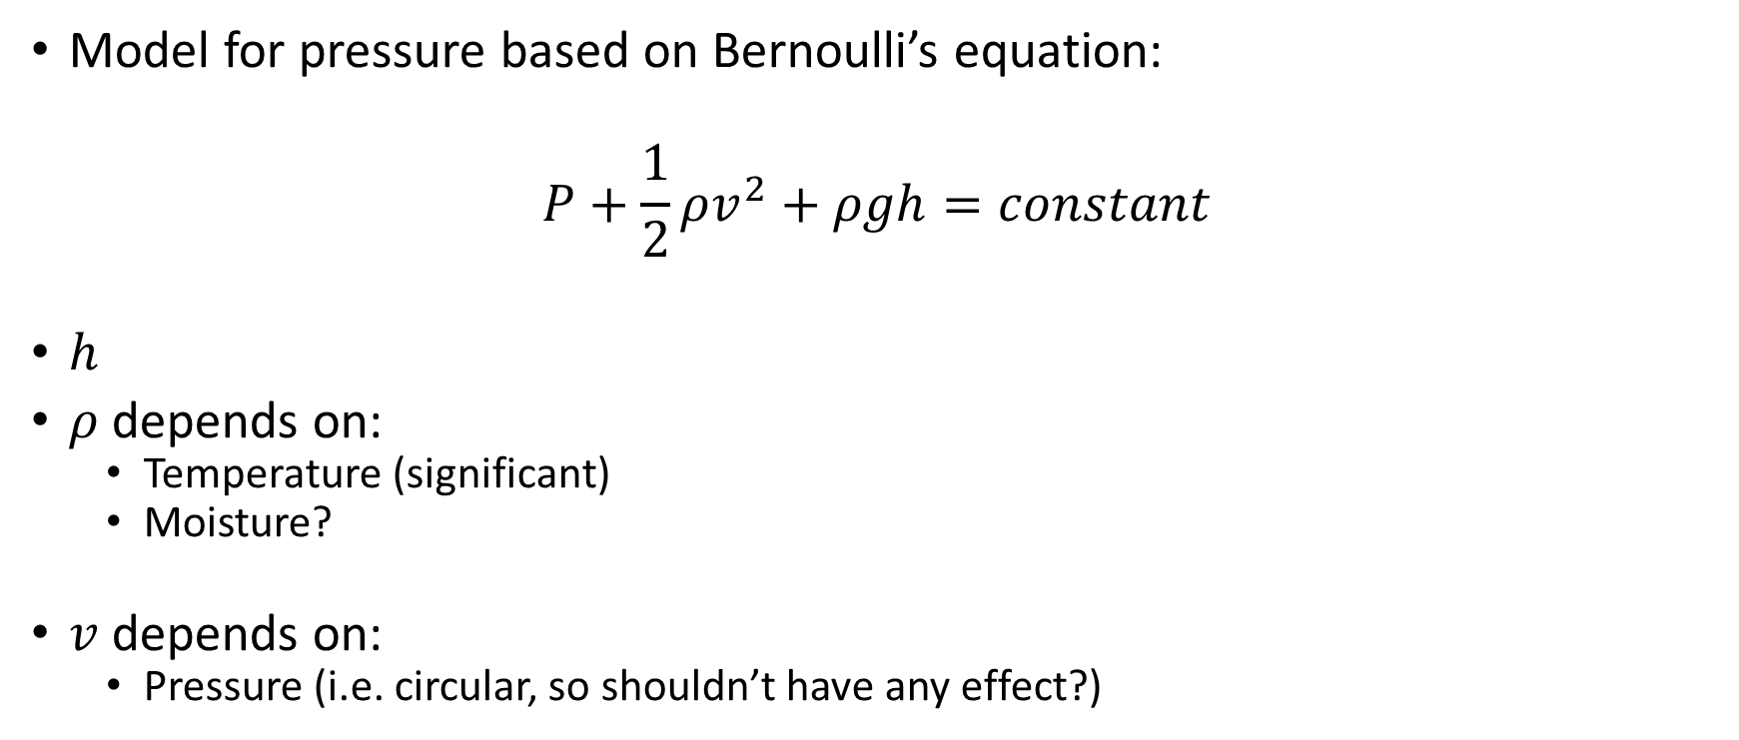
Outliers: v0.03
Model for pressure based on Bernoulli’s equation:
$$P+\frac{1}{2}ρv^{2}+ρgh=constant$$
$h$
$ρ$ depends on:
Temperature (significant)
Moisture?
$v$ depends on:
Pressure (i.e. circular, so shouldn’t have any effect?)

Slide 77

Outliers: v???
First order difference: very long tails
Notes:
Very long tails, not normal

Slide 78
Next steps

Slide 79
Next steps
Make first version of package with outlier detector 0.01 and 0.02?
If no extra data supplied, use v0.01, else v0.02?
v0.02: fixed or dynamic thresholds?
Other ideas?
Notes:
Misschien best om zo snel mogelijk met package te beginnen: dan kan gebruik meteen geevalueerd worden.

Slide 80
The End

